Slide 1

Make Your Vote Count: Redistricting Reform
Fair Districts PA started in 2015 as a project of The League of Women Voters of PA
Notes:
Fair Districts PA came together in January, 2016, when leaders in PA good-government non-profits realized they needed to work together more effectively to support legislators interested in seeing this change. Prior to 2016, redistricting legislation had been introduced and largely gone nowhere since the early 1990’s. Leadership of FDPA is provided by the League of Women Voters of Pennsylvania and Common Cause PA, with member organizations from all sides of the political spectrum and all corners of the state.

Slide 2
How Does PA Redistrict?
Who Creates the Maps: The 1%
203 State House and 50 Senate Districts | 17 PA Congressional Districts
Commission of 5 individuals – The LRC (Four Party Leaders and a Chair) – The 1% House & Senate do not vote on plan Governor does not sign it Commission plan final unless overturned by State Supreme Court or Federal Court | State Legislature – via standard legislative process – and controlled by Majority Party Leaders – The 1%
Laws The 1% Must Follow
PA Constitution Article II, Section 16* | Federal Voting Rights Act
All districts for the same level office must have equal population. Districts must be geographically compact and contiguous. District cannot divide existing geopolitical entities “…unless absolutely necessary.” | Blocks district lines that deny minority voters an equal opportunity “to participate in the political process and to elect representatives of their choice.”
2
*State Districts Only
Notes:
After the decennial census, new maps for representative districts must be redrawn to accommodate the changes in population.
For Congressional Districts, the regular legislature process is followed -- that is a bill passed by both houses and signed by the governor.
State Legislative districts are drawn in accordance with the PA State Constitution (Article 2, Section 17) ,by a bipartisan five member commission – the four Republican and Democratic leaders of the state House and Senate, and a fifth member chosen by the four who becomes the chair. If the four leaders deadlock ,the PA Supreme Court picks the chair.
The Legislative houses do not vote on the mapped plan and the Governor does not sign it. The decision of the commission is FINAL unless overturned by the State Supreme Court or a Federal Court.
Since the standards are not clearly defined, the courts have been reluctant to enforce them.

Slide 3
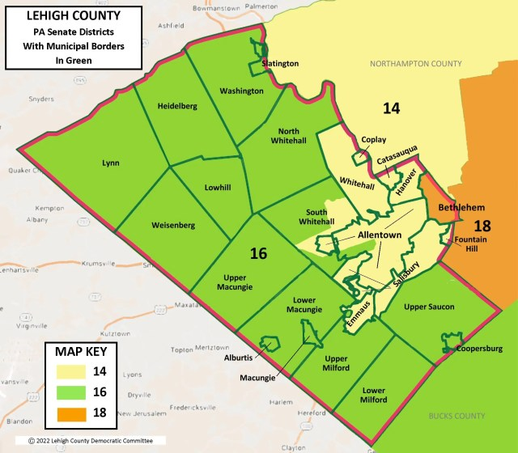
State Senate Districts –
Lehigh & Northampton Counties
Each State Senator covers @265k population - that means Northampton County population (312k) requires 1.2 Senate districts.
Lehigh County population (375k) requires 1.4 Senate districts.
But the 2021 State Senate map is a ‘buddymander’ map, a closed-door agreement between Senate Majority & Minority Leaders on LRC to protect the status quo for both parties. Public and mapping expert testimony was taken for only a few days, then both Senate leaders on the LRC retired for backroom discussions, discarded all public input and drew their own new Senate maps – the politics most of us, including your State Senators, reject.
Senator Miller (14) covers NW Northampton County & Allentown metro area in Lehigh County.
Senator Coleman (16) covers Western Lehigh & Northern Bucks Counties.
Senator Boscola (18) covers Eastern, Central & Southern Northampton County.

Slide 4
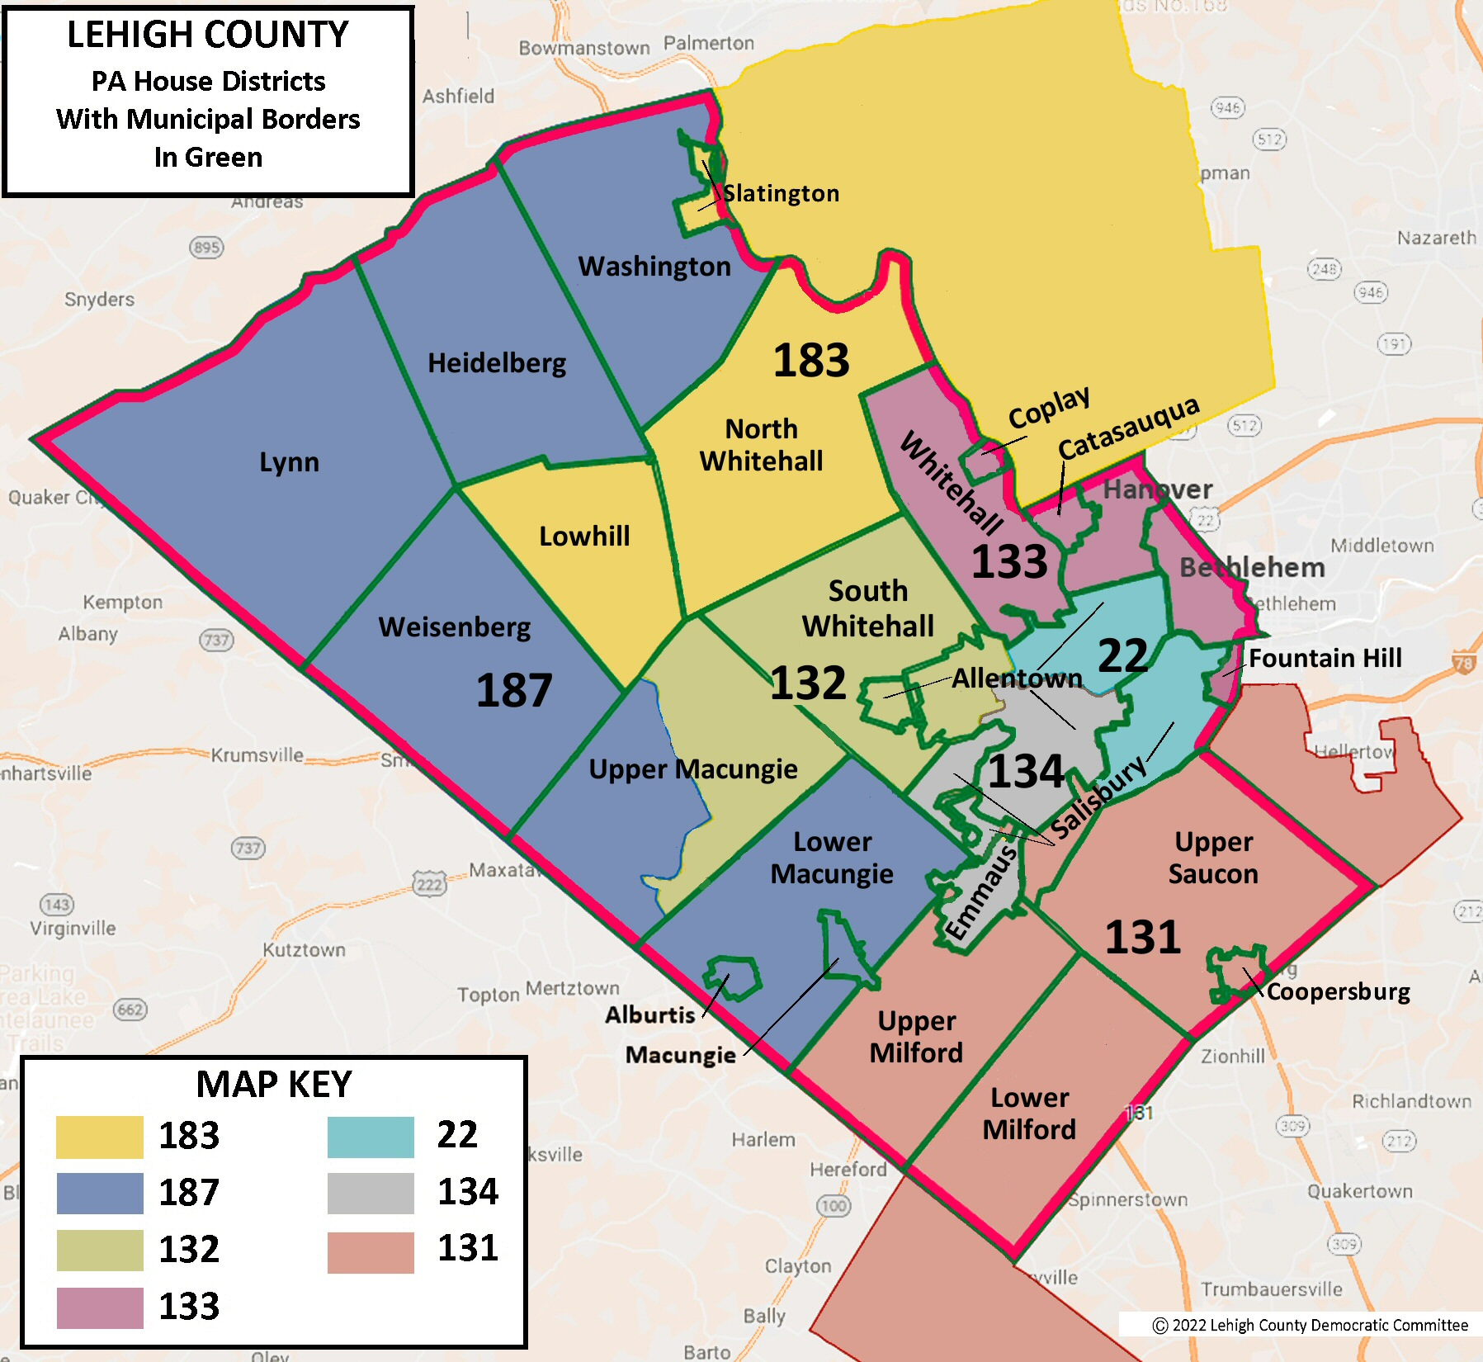
State House Districts:
Lehigh County
But The PA House redistricting process (via the LRC chairman) was more open for public & legislator input – not just theatre.
Each State Rep covers @65k population.
The result for Lehigh County 2020 census population (@375k) requires 6 House districts – and the county got 7, including 1 dual-county district and 1 3-three-county district.
Salisbury (pop 14k) was split 3-ways (22, 131, 134) and Upper Macungie (pop 26.3k) (132, 187) have reason to question map-making decisions.
FDPA Take: Allentown (pop 126k)was a lost opportunity for a majority-minority district, We asked LRC why – no reply.

Slide 5

Gerrymandering: Has Hurt PA
Failing Grades
and
Overdue Reform
Rankings for 2023
Safe Seats = No Urgency to Solve PA’s on-going problems
Notes:
Failing Grades and Overdue Reform- Each year, US. News & World Report releases its annual list of the best and worst states in America to live in, based on "thousands of data points to measure how well states are performing for their citizens.” Pennsylvania was ranked 40th: down from 30th in 2017 and 38th in 2018, far behind our neighboring states.
Every indicator points back to priorities and policy in Harrisburg. Failing grades include:
-treatment of lead in drinking water in schools-https://www.penncapital-star.com/education/map-100-pa-schools-found-lead-in-their-drinking-water-heres-how-they-responded/
-18 cities in PA have worse lead levels than Flint, Michigan due to lead dust in the air-https://www.vox.com/2016/2/3/10904120/lead-exposure-flint-pennsylvania
-PA gets a failing grade for helping college students with costs https://www.inquirer.com/business/student-debt-pennsylvania-colleges-penn-state-20191127.html
Pennsylvania gets F grade in 2015 state integrity investigation https://publicintegrity.org/politics/state-politics/state-integrity-investigation/pennsylvania-gets-f-grade-in-2015-state-integrity-investigation/
Today, PA has an F in legislative agenda fairness https://fairvote.org/report/collaborative_policymaking/
Browse through bills introduced in Harrisburg over the past few decades and you’ll find many designed to address these failures. None are given a hearing or a vote.
https://www.usnews.com/news/best-states/rankings

Slide 6
We Don’t Want Our Legislature or Courts Drawing our Electoral Maps
Fact: Our PA Supreme Court re-drew our Congressional district maps in 2018 and again in 2022 – due to our PA Legislature’s failure to do their job.
Fact: Our 2022 State Senate map is a ‘buddymander.’
Fact: Why Should We Expect This Insiders’ Game to Change Anything in the Future?
Our Proposal: Change the Players and the Process
* End Legislator inherent conflicts of interest
* Enable an Independent Redistricting Commission
* Demand Process Transparency
* Draw New Maps Based on Prioritized Rules
and enable transparency, accountability & clear mapping criteria
6

Slide 7
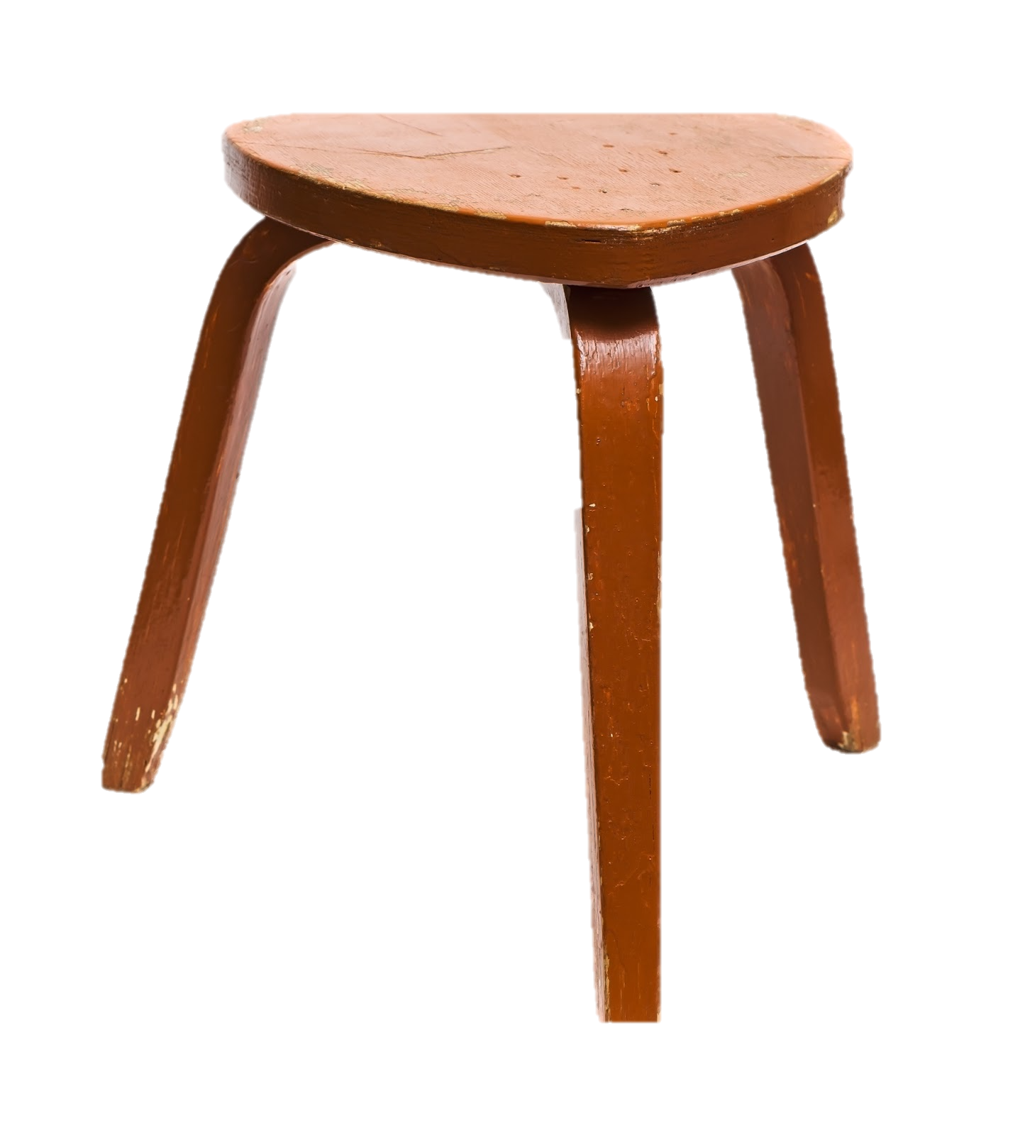
What We Propose: HB31 & SB131
Real Redistricting Reform
HB31/SB131 Key Features:
Three Legs for Balance & Stability
Process Transparency
Commission Independence
Prioritized Mapping Criteria
7
Notes:
Adhere to all Constitution and Voting Rights Act requirements.
Make all districts as equal in population as possible within an established minimal range of deviation.
Respect city and county subdivisions, natural geographic features, and communities of interest.
Encourage geographical compactness.
Not be drawn for the purpose of favoring or discriminating against a political party or candidate.
Fair Districts PA Supports a Constitutional Amendment to Create an Impartial Citizens Redistricting Commission
: One impartial citizens redistricting commission for both congressional and state legislative mapping, and a transparent process

Slide 8
What We Propose: HB31/SB131
Commission Independence
4
4
3
No
Voters registered with largest political party
Voters registered with 2nd largest political party
Voters not registered with either party
Politicians, elected officials, lobbyists, appointed political office-holders or immediate family
The Independent Redistricting Commission (IRC) Selection & Operation Represents Citizens’ Interests, Not Party Leaders’
Notes:
The commission is constituted in the year of the federal census and will consists of 11 members, 4 registered with each of the two major political parties and 3 voters not registered with a major party
Eligibility: Pennsylvania voters registered in the same political party or unaffiliated with a party for the previous five years & voted in no less than 2 of the last 3 statewide general elections
Ineligible persons: candidates or elected or appointed political office-holders; members of a political party governing body, PAC or political campaign; employees, consultants or close family members of the foregoing; registered lobbyists
Commissioners cannot serve in above capacities for a period of 5 years before and after service on the commission
The commission shall reflect Pennsylvania’s geographic, ethnic, racial & gender diversity
Beginning January 1 in the year of the census, the commission application process is widely publicized to reach as many potential applicants as possible
The Department of State reviews applications and divides applicants into 3 pools: the party with the largest number of registered voters, the party with the 2nd largest number of registrants; unaffiliated and 3rd party voters
The State Ethics Commission narrows the pools to the 60 most qualified
House and Senate majority and minority leaders may each strike up to two applicants from each pool
At a public event, the Secretary of State will randomly select 8 applicants: 3 from each major party pool and 2 from the unaffiliated/minor party pool.
Three additional candidates, one from each pool, will be chosen by the State Ethics Commission to further balance demographics and add needed skills and experience
The commission may vote to remove a commissioner for cause with vacancies to be filled by the State Ethics Commission from the original pool of applicants

Slide 9
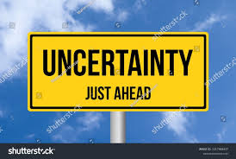
What We Propose: Looking Ahead
If Nothing Changes re: Our Redistricting Process, in 2031:
3-4 Majority Party Leaders will still draw all new maps
Back-room map decision-making process will remain intact
Personal data will continue to be used by leaders
Voters registered with 3rd parties will still be shut out
Our PA Supreme Court will likely get involved/draw maps again
And citizens like us will just have to take what we get
But This Fact About 2031 is Also True:
Nobody knows who will control our PA House, PA Senate or PA Supreme Court when new maps must be re-drawn:
So We Ask All Our State Legislators: Why Take Such A Career Risk?
Co-sponsoring our proposed CA is the easy, sensible first step.
Finally, we ask: Are you OK with our current redistricting process?
We’ll need to amend our PA Constitution – so we need to get started now!
Notes:
Commissioners will receive training and orientation in topics including (but not limited to) the Voting Rights Act, mapping tools, redistricting criteria, and effective redistricting processes from other state
Redistricting data, mapping technology, and all meeting transcripts and recordings will be accessible to the public on a free communications platform
Data for incarcerated persons will reflect last known address (unless outside Pennsylvania) rather than place of incarceration
Actions of commissioners are to be held at widely publicized public meetings
At least 8 public meetings will precede drawing of maps, with another 8 required after preliminary maps are made public; at least 4 of each must be held in PA’s 4 largest cities.
Actions by the commission shall be in a public meeting with affirmative votes of at least seven commissioners, including at least 2 commissioners from each pool
PA open meeting laws apply including restrictions on ex parte communications

Slide 10
Lehigh County:
Local Legislator HB31/SB131 Support
Sen Jarrett Coleman (18) No
Sen Nick Miller (14) Not Yet
Sen Lisa Boscola Yes
Rep Josh Siegel (22) Not Yet
Rep Milou Mackenzie (131) No
Rep Michael Schlossberg (132) Undecided
Rep Jeanne McNeill (133) Yes
Rep Peter Schweyer (134) ) Undecided
Rep Zach Mako (183) No
Rep Gary Day (187) No
Your future outreach to your State Rep & Senator is much appreciated.

Slide 11

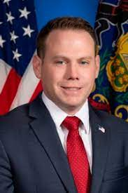
Lehigh County:
Local Legislator Follow-Up
Rep Milou Mackenzie
Senator Jarrett Coleman
* Call/Email to Co-Sponsor HB31
Talk to R-Prime Sponsor Gillen
Ask for a April-May Constituent Meeting to Discuss HB31
* Call/Email to Co-Sponsor SB131
Talk to Prime Sponsor Kearney
Ask for a April-May Constituent Meeting to discuss SB131

Slide 12

Gerrymandering 101
12
Notes:
The problem with this process is the inherent conflict of interest. Politicians pick their voters rather than voters picking their politicians .
The same people who draw the maps have a vested interest in creating districts that will help them stay in office
The name was coined in 1812 when Massachusetts Governor, Elbridge Gerry, signed a bill that drew senate districts to benefit his own party the Democratic-Republican Party, which was in opposition to the Federalists. In 1812 MA Gov. Eldridge Gerry approved a bill that drew districts favoring his party. The Boston Gazette published this cartoon showing how one of the districts resembled the shape of a monster. Some thought his map looked like a salamander - hence the term Gerrymander.

